Slide 1
軟體工程設計 W11
許庭瑋、陳君翰、洪世彬、劉玠均、楊昕叡、林俊佑
2023/11/30

Slide 2
Homework

Slide 3
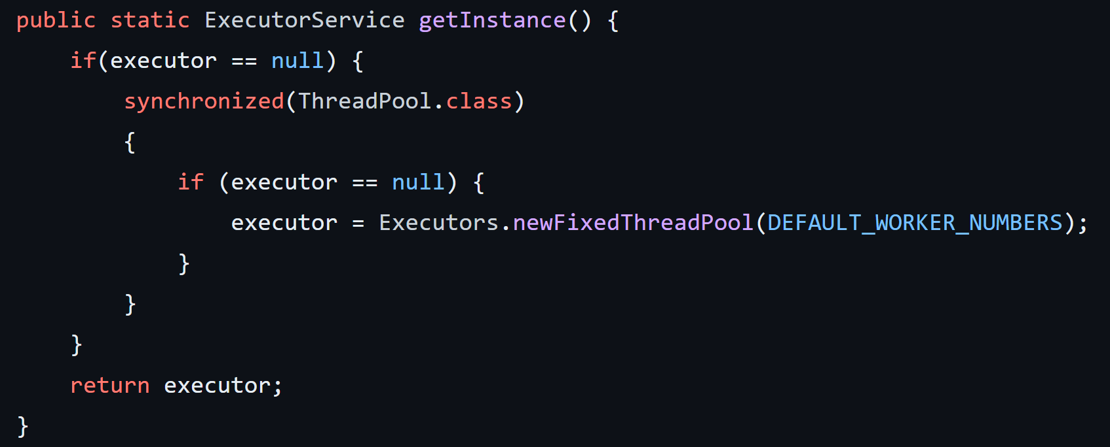
HW 0-1
What is thread pool?
A thread pool is a collection of threads that can be used to perform several tasks in the background without interrupting the main program.
What’s the difference between thread pool and connection pool?
Both are pools, but different things in the pool. Thread in thread pool, connection in connection pool.
Create a thread pool
with Singleton Pattern.

Slide 4
HW 0-2
What’s an immutable object?
An immutable object is an object whose internal state remains constant after it has been entirely created. For example, String is immutable object in JAVA.
Are methods in Java mutable or immutable by default?
The Method is by default overrideable by subclasses unless the final keyword is added.
However, we did not find any mention of an 'immutable method'. We are uncertain whether the question refers to the act of overriding in this context.
Notes:
String Class is immutable

Slide 5
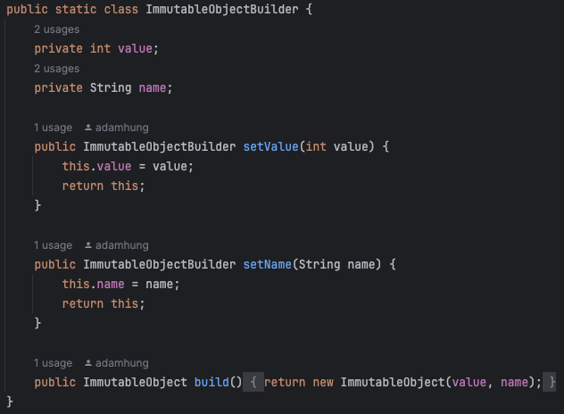

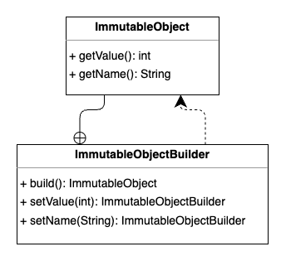
HW 0-2
Create immutable objects with Builder pattern.
Notes:
String Class is immutable

Slide 6
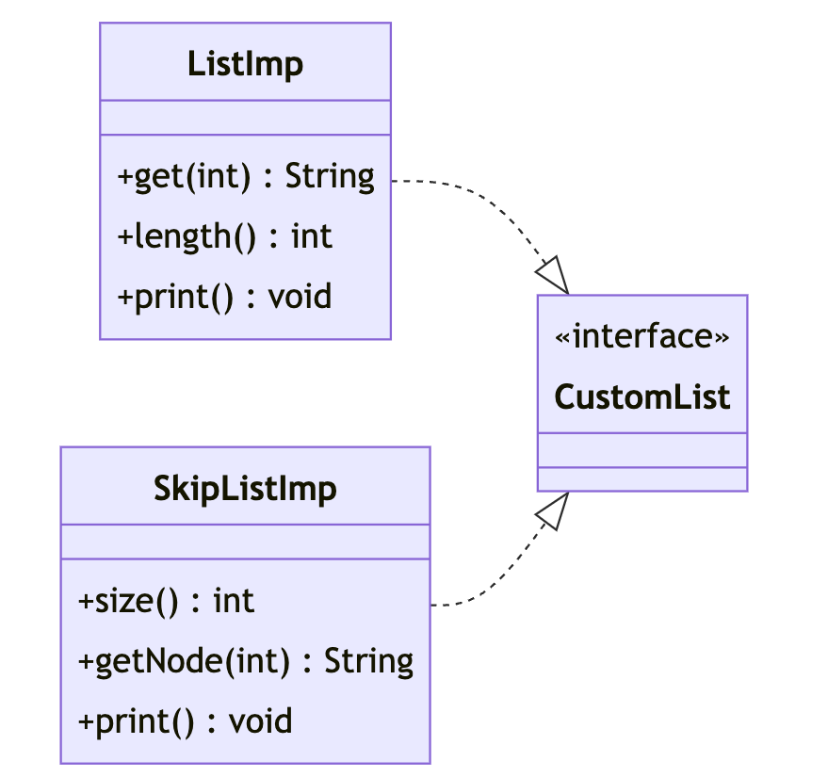
HW1 - Print Out
A List data structure is implemented with a String array which can contain a series of String objects.
We can access List by calling the get() method with an index and know how many Strings inside the List with a public attribute: length.
Furthermore, another data structure called SkipList which consists of a series of SkipNodes.
Each SkipNode can be accessed by invoking the getNode() method in SkipList with an index. And we have the idea about the size of SkipList with its size() method.
Now we have to traverse both List and SkipList to print out those object items in the two different data structures for some purpose.
classDiagram
direction LR
class ListImp {
+ get(int) String
+ length() int
+ print() void
}
class SkipListImp {
+ size() int
+ getNode(int) String
+ print() void
}
class CustomList {
<<interface>>
}
ListImp ..|> CustomList
SkipListImp ..|> CustomList
Notes:
String Class is immutable

Slide 7
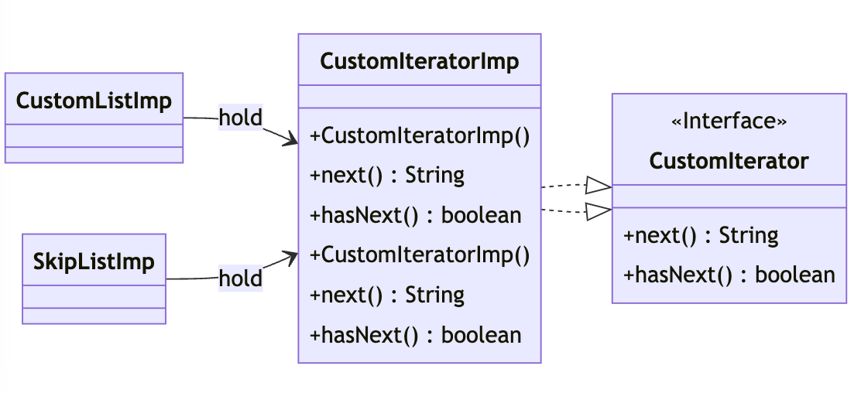
HW1 - Print Out

Slide 8
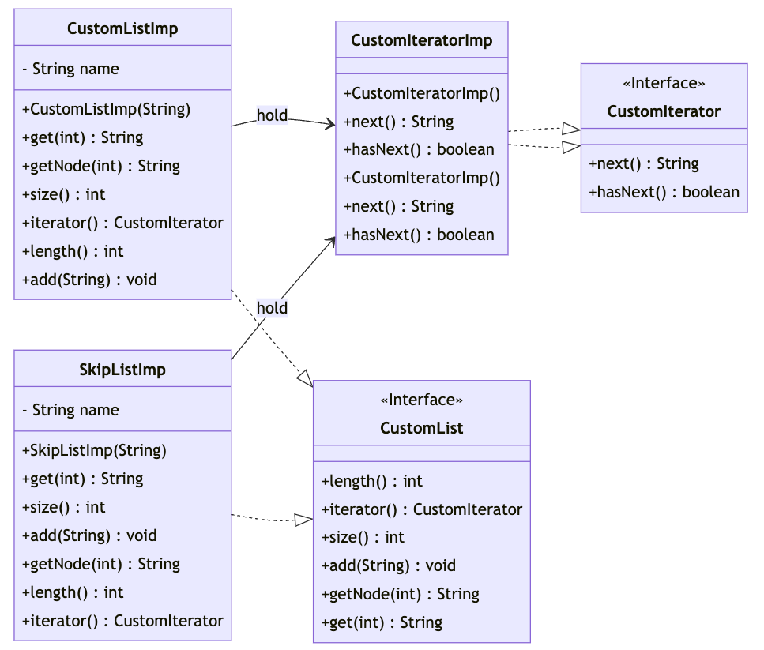
HW1 - Print Out
classDiagram
direction LR
class CustomIterator {
<<Interface>>
+ next() String
+ hasNext() boolean
}
class CustomIteratorImp {
+ CustomIteratorImp()
+ next() String
+ hasNext() boolean
}
class CustomIteratorImp {
+ CustomIteratorImp()
+ next() String
+ hasNext() boolean
}
class CustomList {
<<Interface>>
+ length() int
+ iterator() CustomIterator
+ size() int
+ add(String) void
+ getNode(int) String
+ get(int) String
}
class CustomListImp {
+ CustomListImp(String)
- String name
+ get(int) String
+ getNode(int) String
+ size() int
+ iterator() CustomIterator
+ length() int
+ add(String) void
}
class SkipListImp {
+ SkipListImp(String)
- String name
+ get(int) String
+ size() int
+ add(String) void
+ getNode(int) String
+ length() int
+ iterator() CustomIterator
}
CustomIteratorImp ..|> CustomIterator
CustomIteratorImp ..|> CustomIterator
CustomListImp --> CustomIteratorImp : hold
SkipListImp --> CustomIteratorImp : hold
CustomListImp ..|> CustomList
SkipListImp ..|> CustomList
Notes:
String Class is immutable

Slide 9
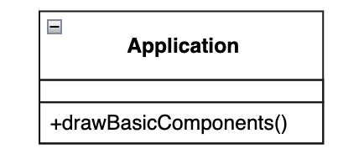
HW2 - Schema Capture System
In schematic capture application, there are some basic components that can be drawn such as Text, Line and Rectangle.
Notes:
String Class is immutable

Slide 10
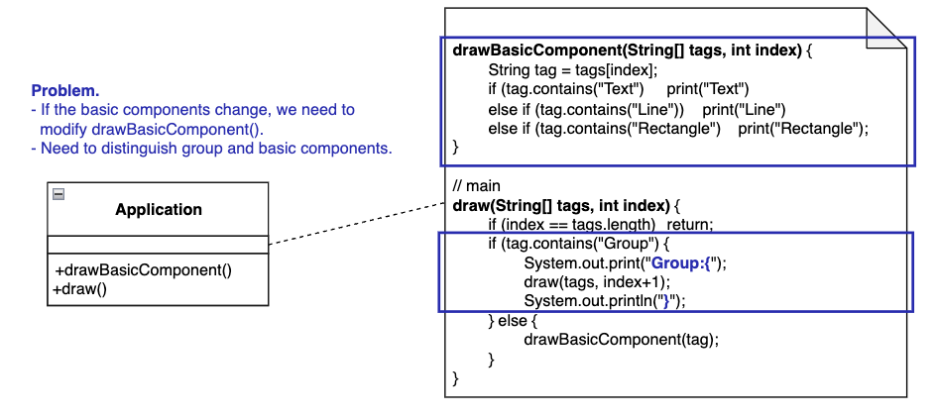
HW2 - Schema Capture System (Initial Design)
The user can group basic components to form larger components, which in turn can be grouped to form still larger components.
Notes:
String Class is immutable

Slide 11
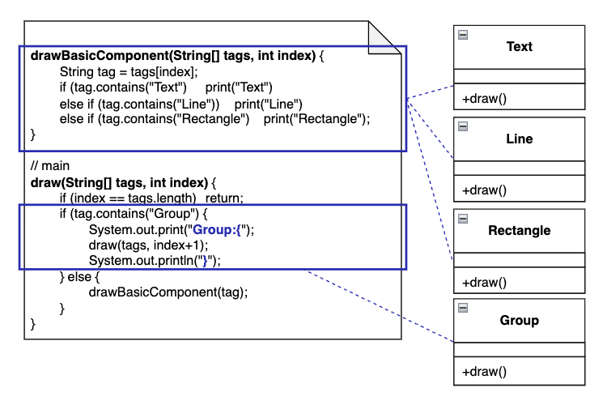
HW2 - Encapsulate What Varies
Notes:
String Class is immutable

Slide 12
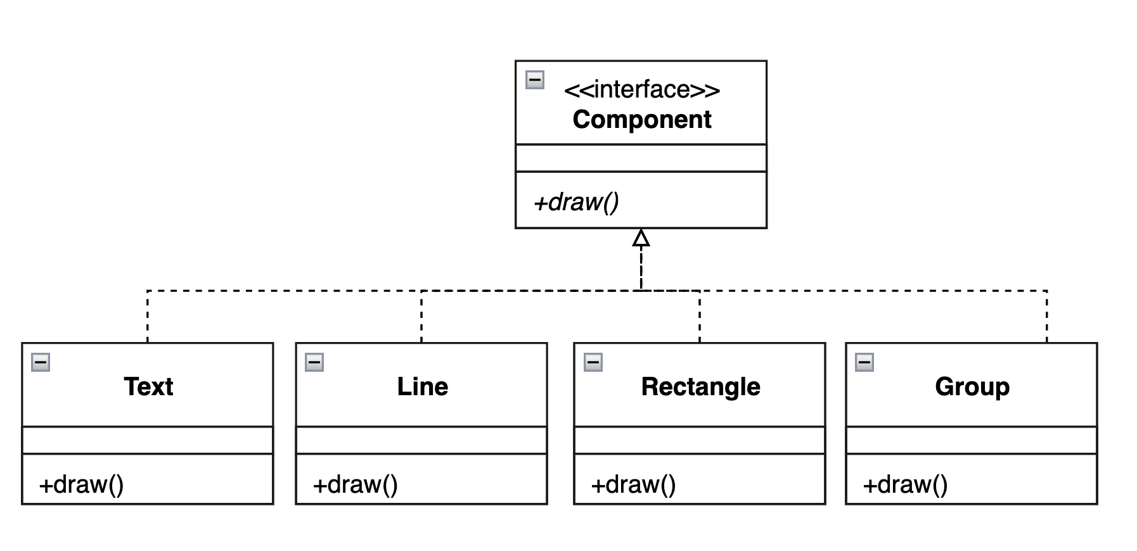
HW2 - Abstract Common Behaviors
Add interface Component
Notes:
String Class is immutable

Slide 13
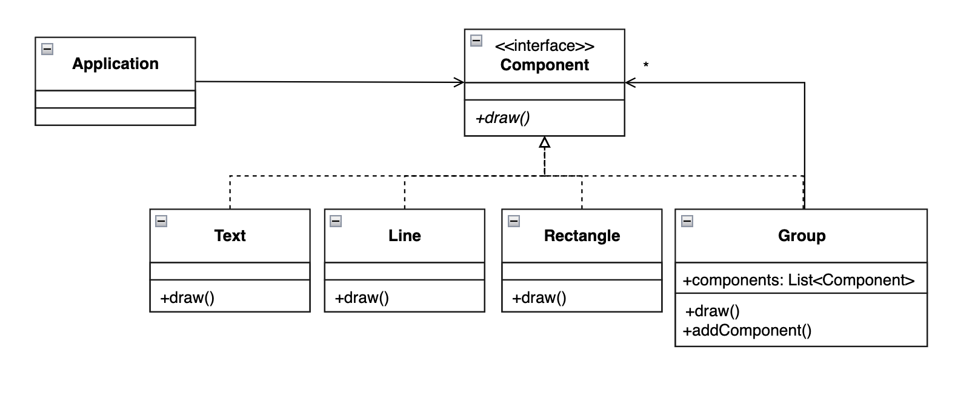
HW2 - Delegate Abstract Behavior (Refactored Design)
Notes:
String Class is immutable

Slide 14
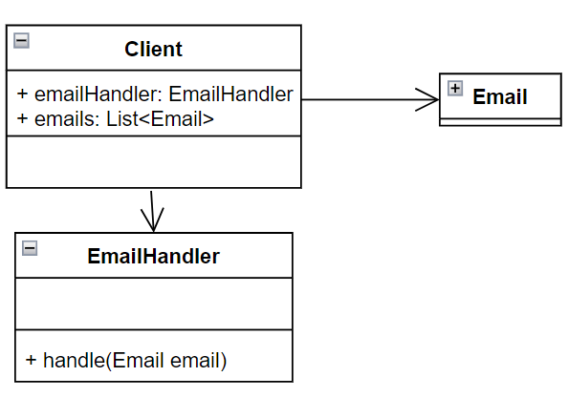
HW3 - Email Handler
An Email Handler for enterprise has ability to handle allreceived emails.
Notes:
String Class is immutable

Slide 15
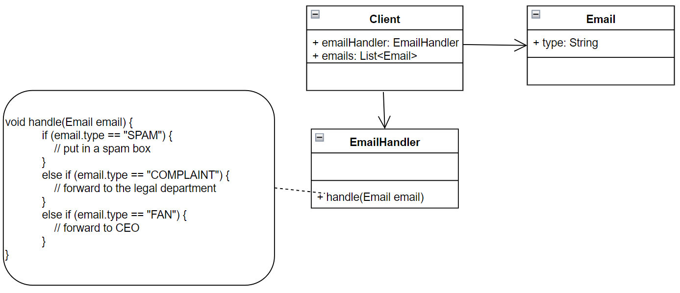
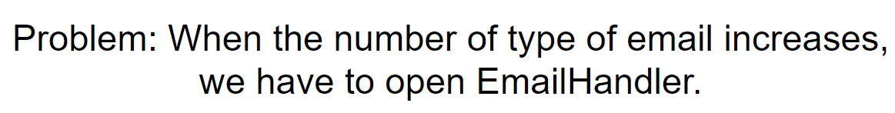
HW3 - Email Handler - Initial Design
The mail handling process of the Email Handler is as follows:
If an email is a spam, it will be put in a spam box.
If an email is a complaint mail rather than a spam, it will be forwarded to the legal department.
If an email is a fan email, it will be forwarded to the CEO.

Slide 16
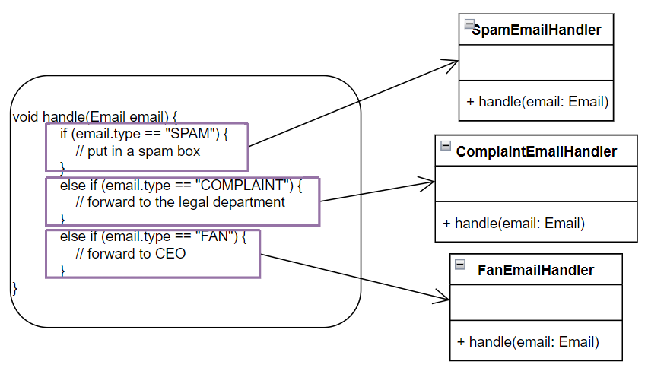
HW3 - Email Handler - Encapsulate What Varies

Slide 17
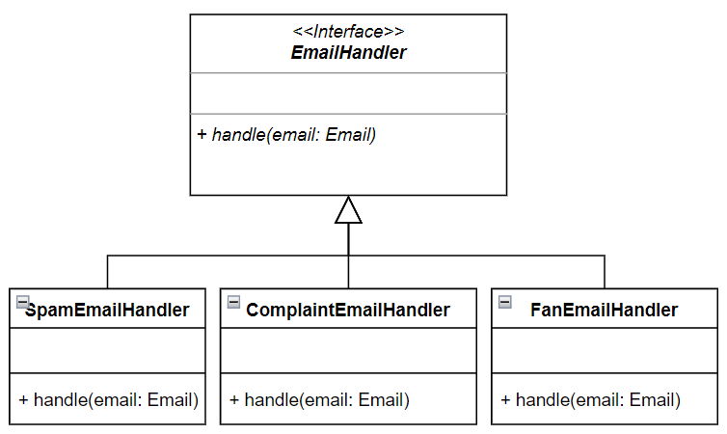
HW3 - Email Handler - Abstract Common Behaviors

Slide 18
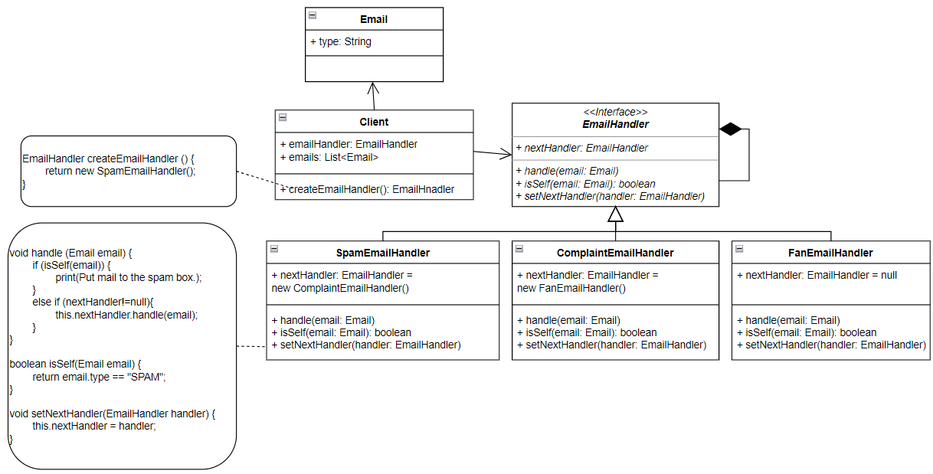
HW3 - Email Handler - Delegation

Slide 19
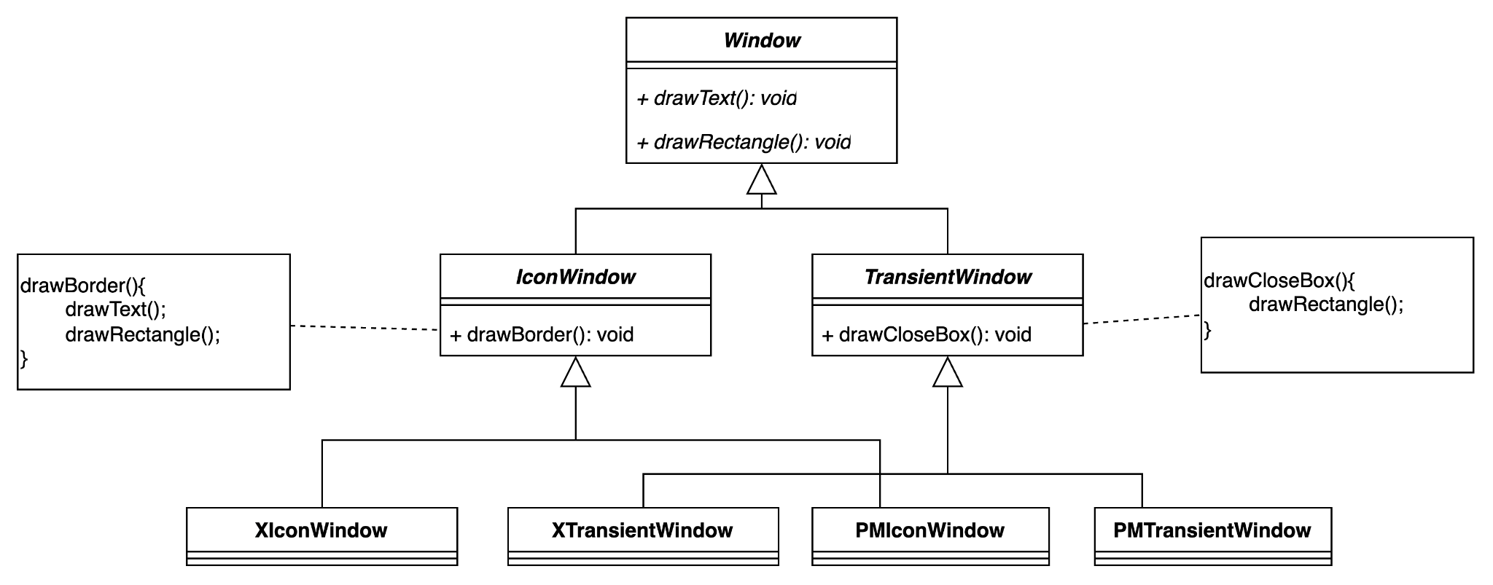
HW4 - window framework - initial design
(XWindow, PMWindow) x (XWindow, PMWindow) = 4 different classes
Notes:
String Class is immutable

Slide 20
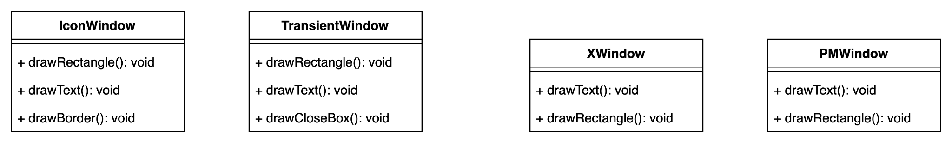
HW4 - window framework - encapsulation

Slide 21
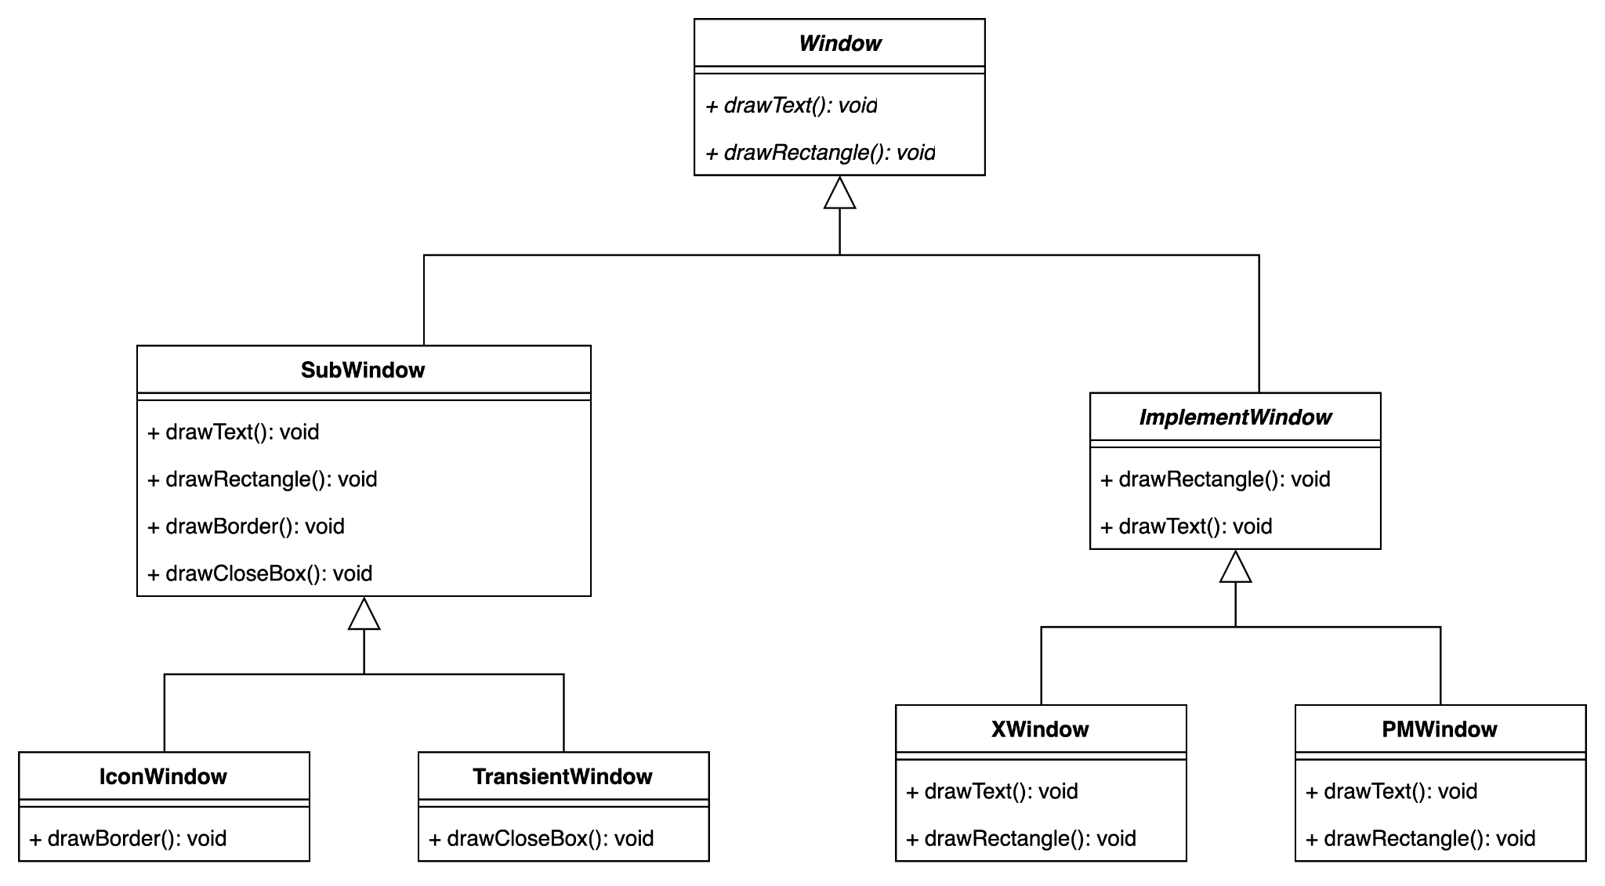
HW4 - window framework - abstraction

Slide 22
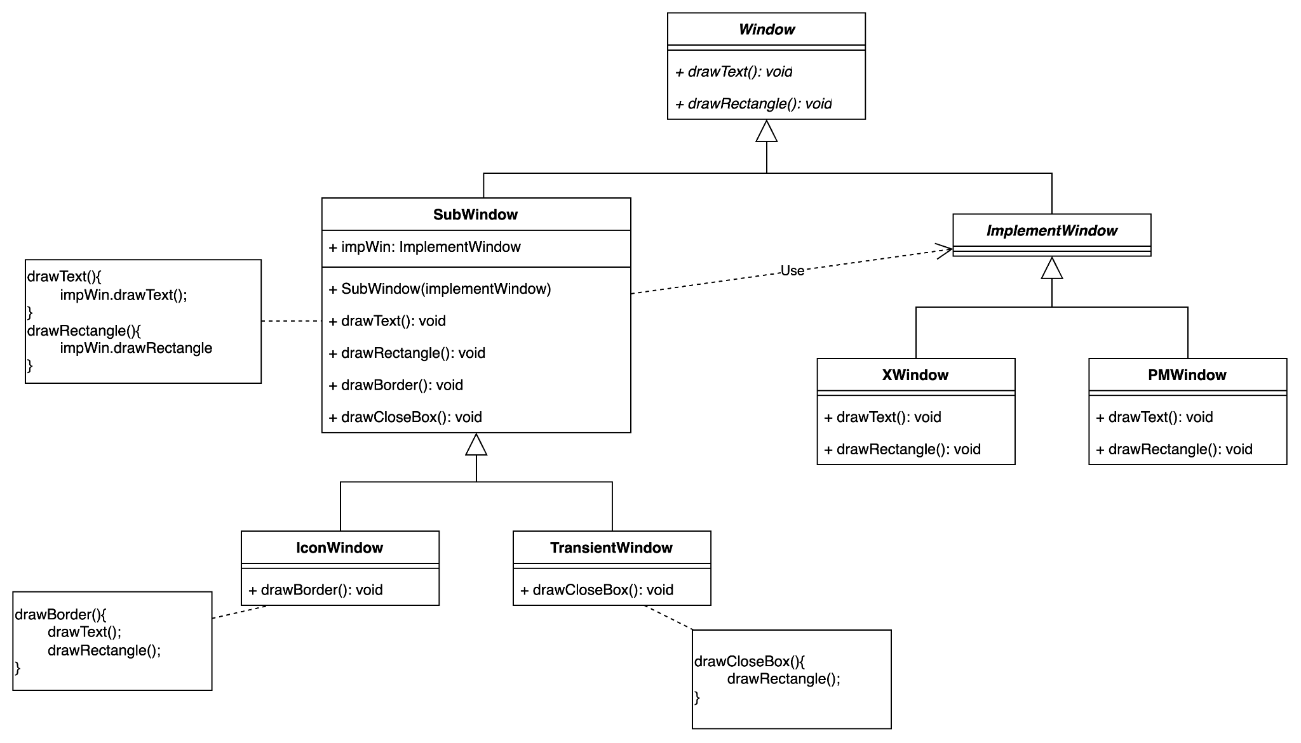
HW4 - window framework - delegation

Slide 23
Code Tracing

Slide 24
Weekly Code Tracing Progress
 | Part | LOC
spring-core-core
許庭瑋 | LimitedDataBufferList.java, DataBufferInputStream.java, DataBufferOutputStream.java, SpringFactoriesLoader.java | 505
楊昕叡 | AnnotationUtils.java | 504
劉玠均 | type/classreading (1/2) , type/StandardAnnotationMetadata, StandardMethodMetadata | 491
洪世彬 | GenericTypeResolver.java, CollectionFactory.java, Conventions.java | 575
spring-core-aot, spring-core-cglib
陳君翰 | org.springframework.cglib.transform (尾段) + org.springframework.cglib.transform.impl (開始) | 432
林俊佑 | CGLIB.BEAM.BeanGenerator + ImmutableBean | 407

Slide 25
許庭瑋
DataBufferInputStream
use interface DataBuffer
An OutputStream that writes to a DataBuffer
write: check if the stream is closed, ensure this stream can be written, then write
DataBufferInputStream
An InputStream that reads from a DataBuffer.
read: check if the stream is closed, ensure there is something to be read, then read

Slide 26
許庭瑋
LimitedDataBufferList
extends ArrayList<DataBuffer>, enforce a limit on the total number of bytes buffered.
updateCount: check if total bytes exceed this.maxByteCount. If yes, throw DataBufferLimitException.
SpringFactoriesLoader
General purpose factory loading mechanism in Spring, important in using Spring Boot
load: Load and instantiate the factory implementation.
ArgumentResolver: Strategy for resolving constructor arguments based on their type

Slide 27
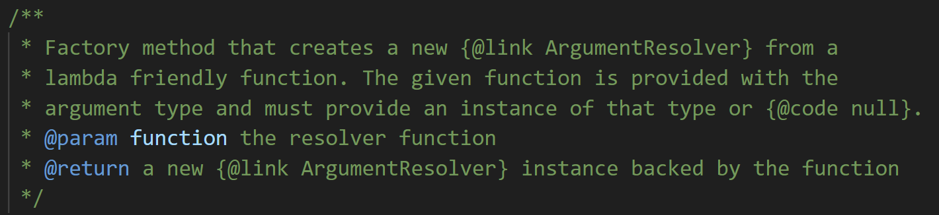
許庭瑋
SpringFactoriesLoader
ArgumentResolver: an interface, strategy for resolving constructor arguments based on their type
from: creates a new ArgumentResolver with specific type
and: Create a new composed ArgumentResolver with specific argument
In fact, although many comments of function in ArgumentResolver said the method is Factory method, it is not Fatory pattern, because it doesn’t seperate those functions into another class.
FailureHandler: an inner interface, handling a failure in SpringFactoriesLoader

Slide 28
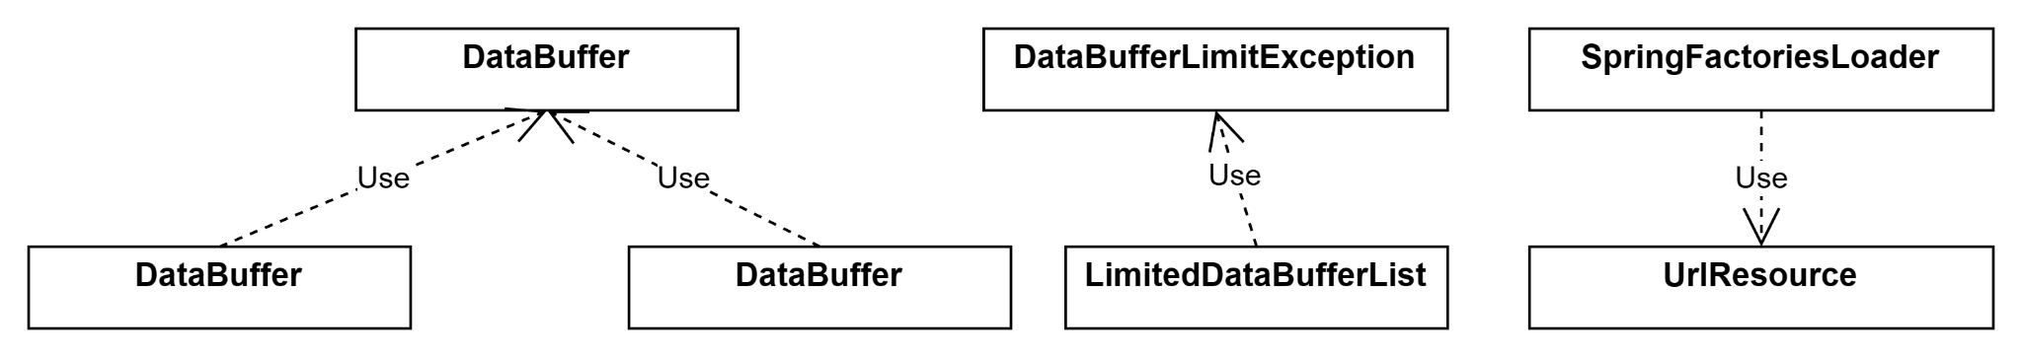
許庭瑋
SpringFactoriesLoader
FactoryInstantiator: inner class, create the factory instance
resolveArgs: use ArgumentResolver.resolve to get args
instantiate: use resolveArgs to get args, and use Constructor.newInstance(args) to create new instance
Diagram

Slide 29
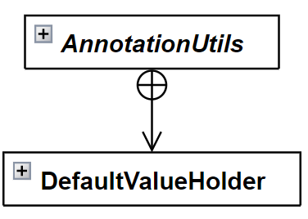
楊昕叡
class diagram: full version
public abstract class AnnotationUtils
This class provides abundant utility methods for working with annotations. It seems that most operations about spring-core annotations can be accessed from here. In other words, this class composites other classes’ methods to provide utility methods, avoiding misuse of methods in those classes.

Slide 30
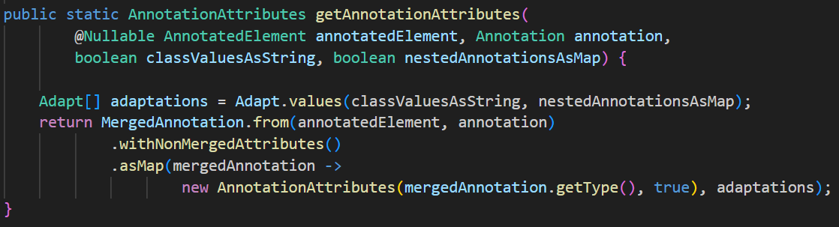
楊昕叡
For example, getAnnotationAttributes() composite methods in MergedAnnotation to get a map of an annotation’s attributes and return it.
This behavior is partly similar to builder pattern, but steps to construct and return are all inside a method here.

Slide 31
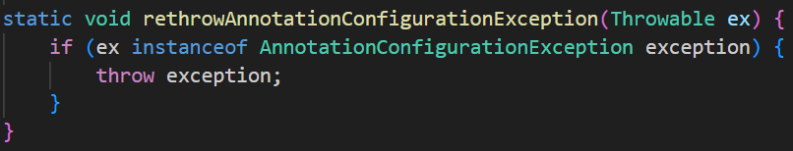
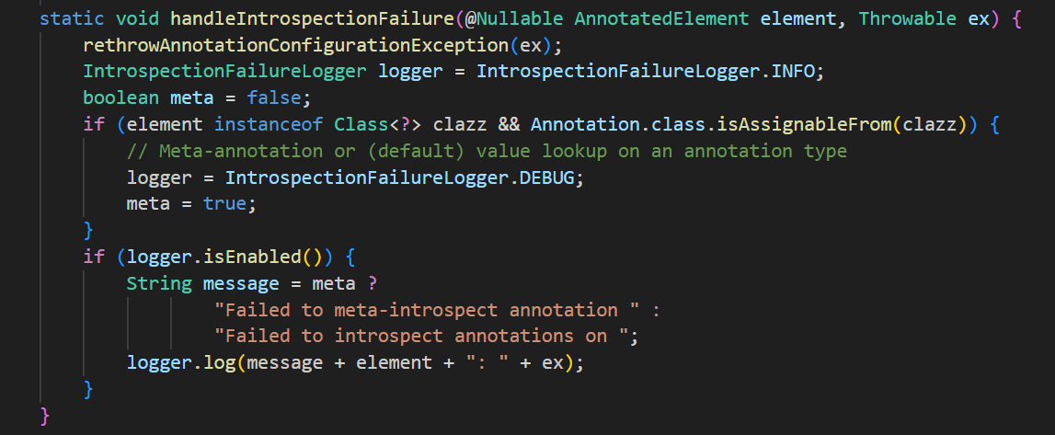
楊昕叡
This two methods handle two types of exception. handlerIntrospectionFailure() calls rethrowAnnotationConfigurationException(), so they are a part of chain of responsibility.

Slide 32
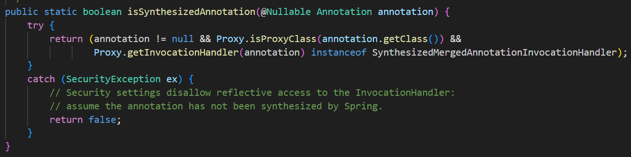
楊昕叡
isSynthesizedAnnotation() uses methods from a proxy class.

Slide 33
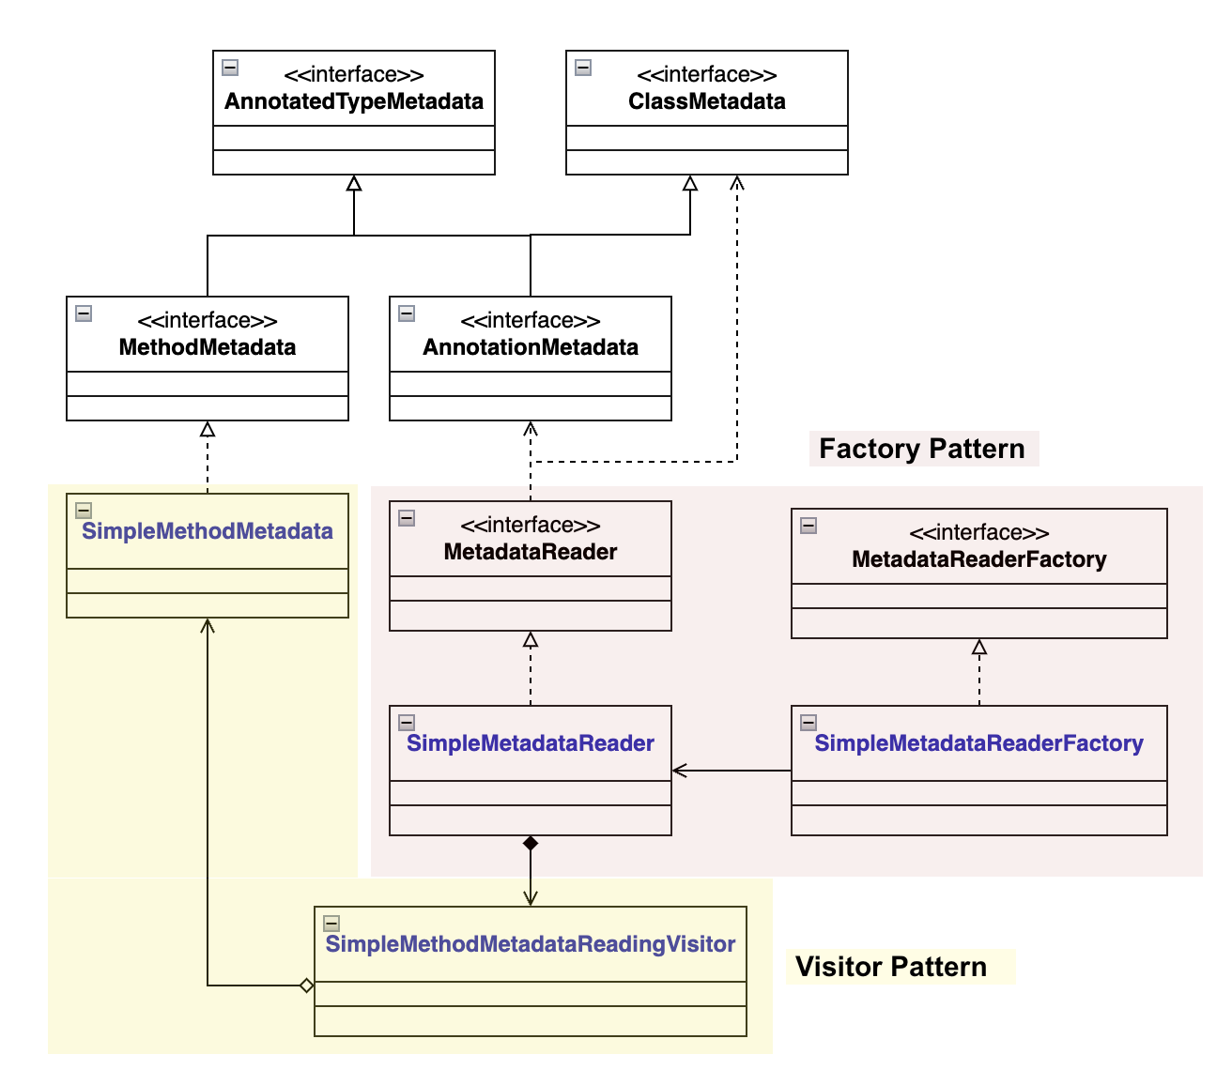
劉玠均
Class diagram full version
In type/classreading, there are two design patterns: factory pattern (red) and visitor pattern (yellow).

Slide 34

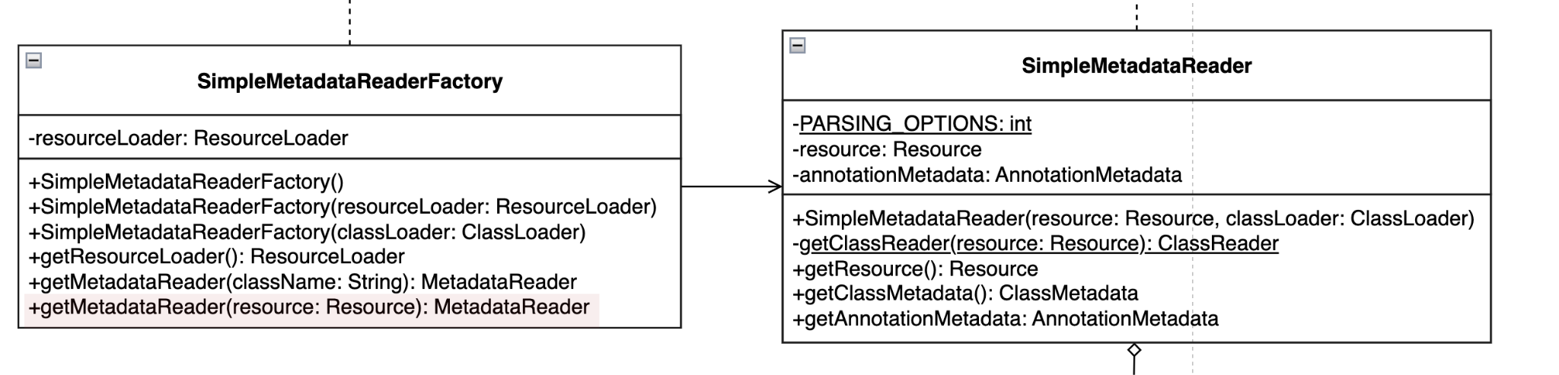
劉玠均
Factory Pattern SimpleMetadataReaderFactory is a concrete factory that allows users to get a new instance of SimpleMetadataReader via getMetadataReader function.

Slide 35
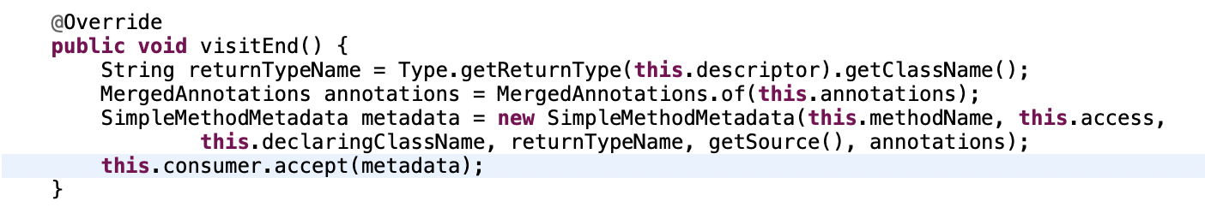
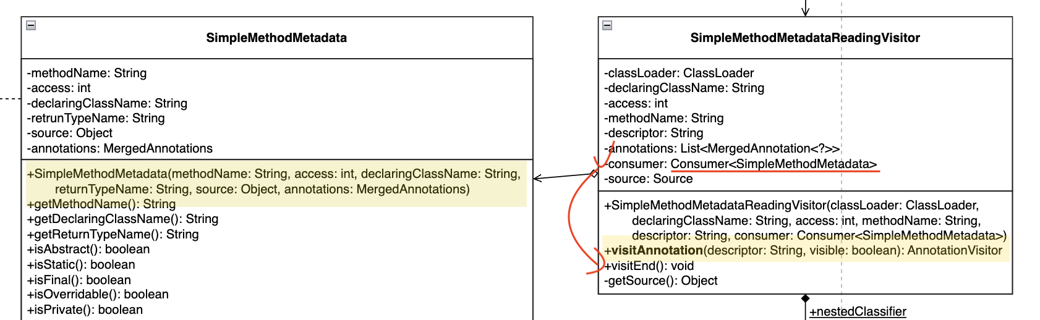
劉玠均
Visitor Pattern SimpleMethodMetadataReadingVisitor can visit SimpleMethodMetadata through the accept function (see visitEnd()).

Slide 36
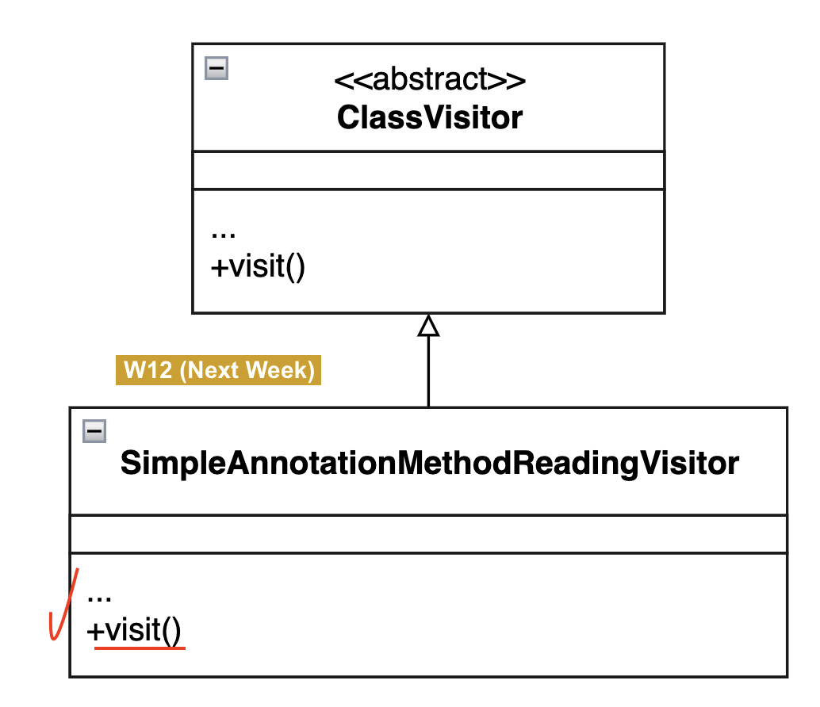
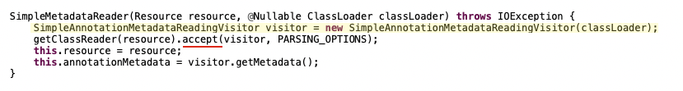
劉玠均
Visitor Pattern (Cont.)
However, for visiting Annotations, it is done by passing in SimpleAnnotationMethodReadingVisitor to the accept function.
In the code snippet below, accept(visitor, …)allows visitor to visit the resource through visit().

Slide 37
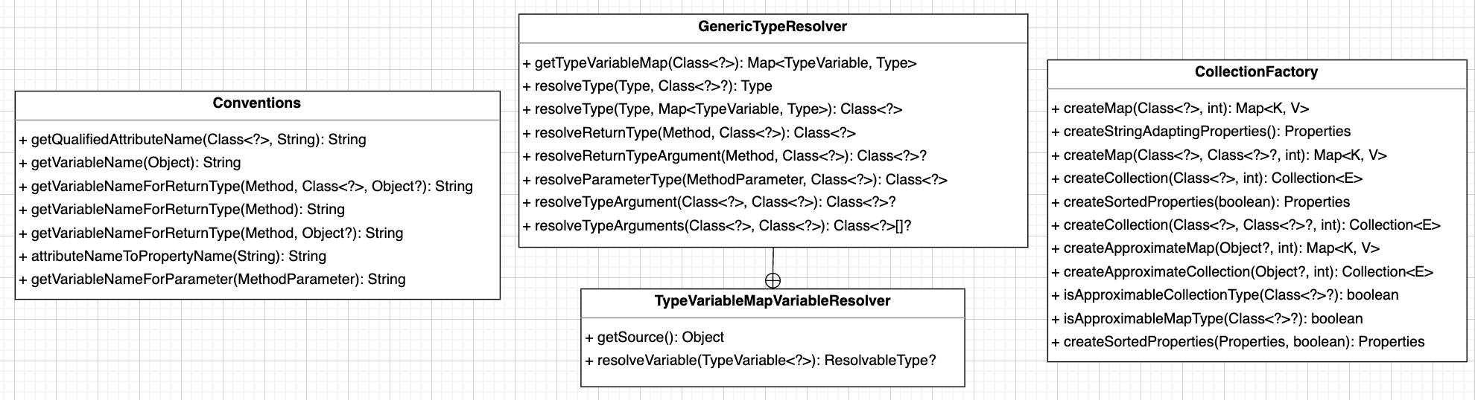
洪世彬
I attended three classes this week. They were not related to each other, so compared to the content of the previous weeks, it was relatively simpler.

Slide 38
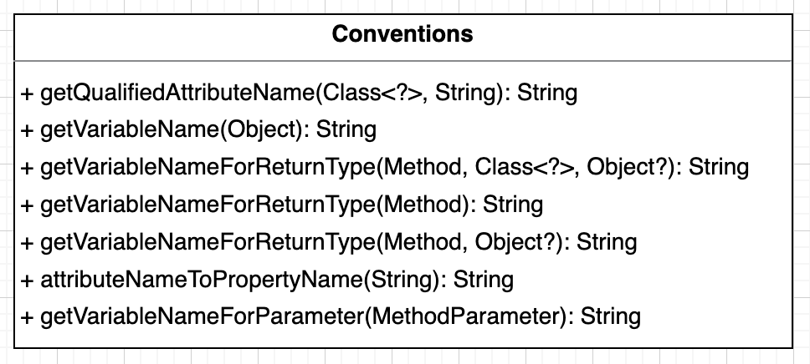
洪世彬
The first class is 'Conventions'. It mainly serves for internal purposes within the framework and allows various objects to be converted into string representations.

Slide 39
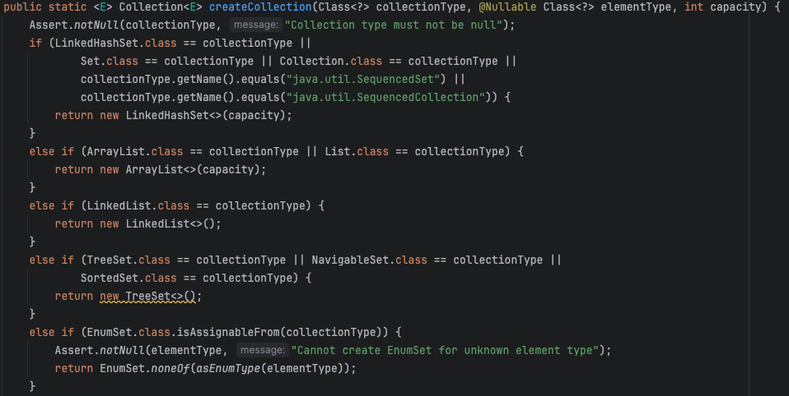
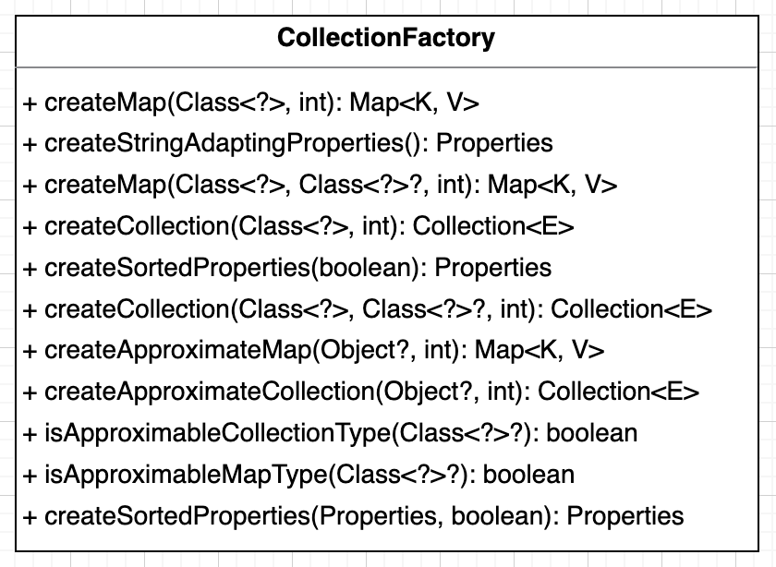
洪世彬
The second class is 'CollectionFactory', also used internally in the framework. It employs a static factory approach to enable developers to create instances of collections.

Slide 40
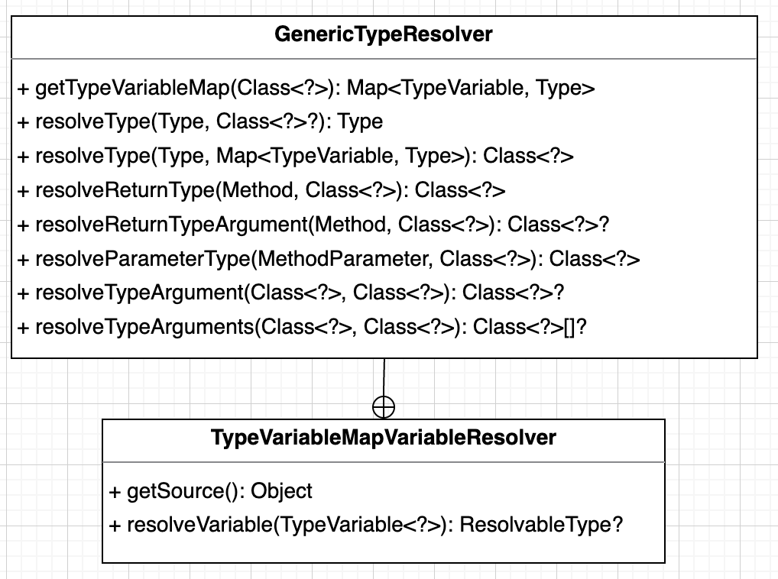
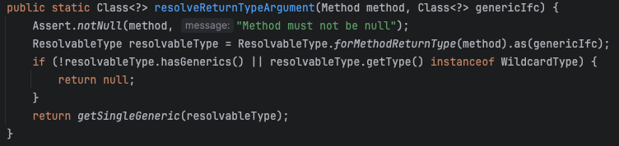
洪世彬
The last one is 'GenericTypeResolver', primarily used within the framework as well. The class internally invokes the functionalities provided by 'ResolvableType', allowing developers to more conveniently obtain the generic type defined in a class or function.

Slide 41
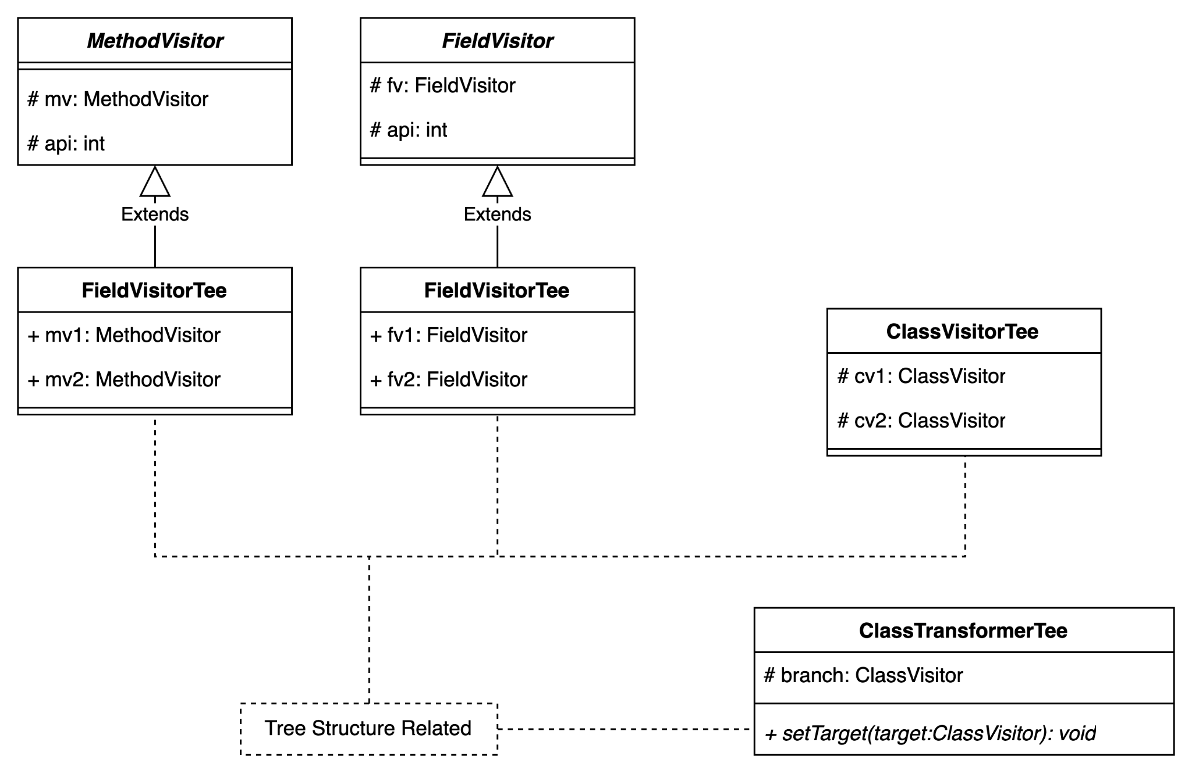
陳君翰
把許多既有的class (classVisitor, ClassTransformer, MethodVisitor, FieldVisitor)延伸出去，變成 tree structure

Slide 42
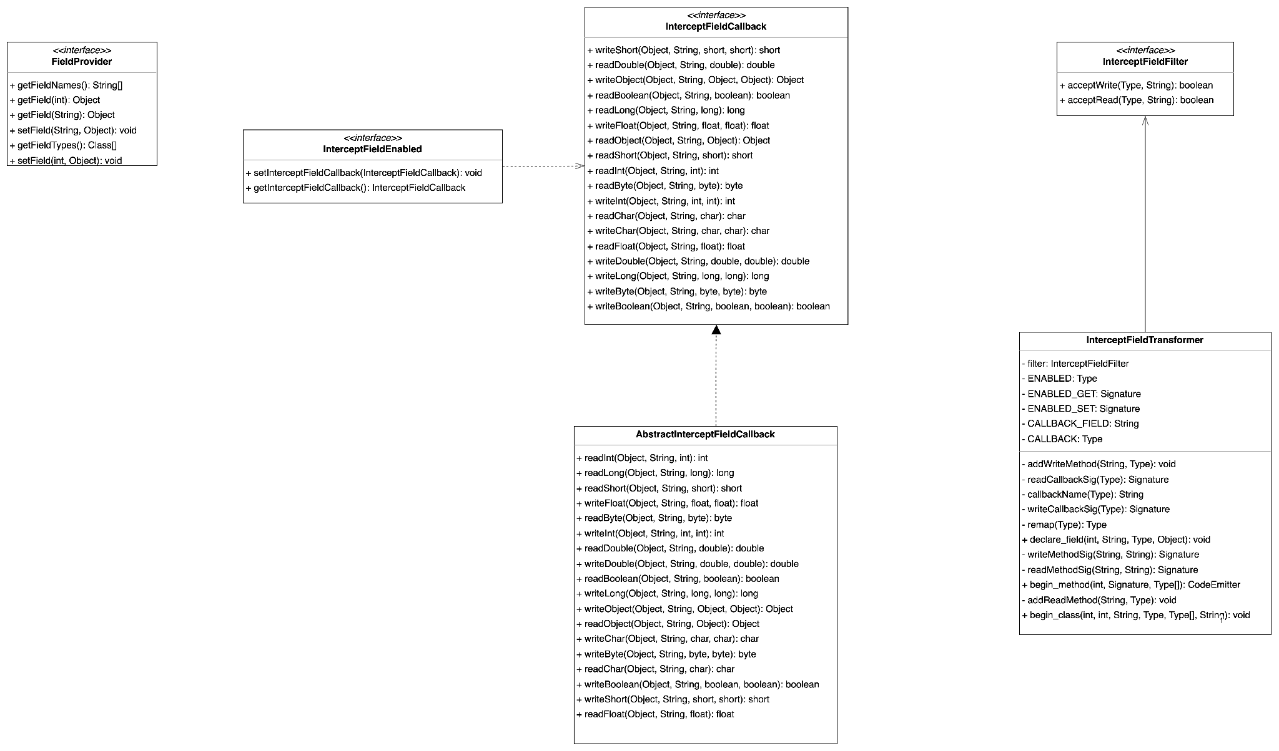
陳君翰
implementation 的 interface，目前許多 interface 看起來應該並沒有太多作用
下週有許多關於 ClassEmitterTransformer 的子類別需要閱讀，難度將會大幅提高

Slide 43
林俊佑
開始閱讀 beam package
首先透過閱讀官方文件初步了解名詞定義
Introduction to the Spring IoC Container and Beans :: Spring Framework
結論
Bean 的概念類似 C# MVC 的依賴注入，可以用在統一初始化物件後在想使用的地方引入, 只要有完成物件註冊。該事先初始化的物件稱為 Bean, 而維護 Bean 依賴注入的部分稱為 IoC 容器。

Slide 44
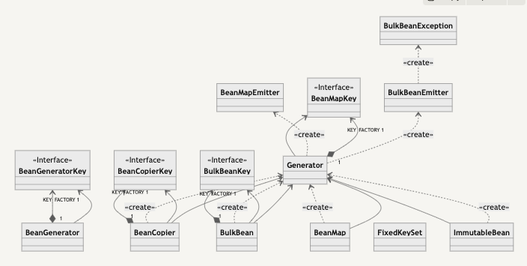
林俊佑
Bean

Slide 45
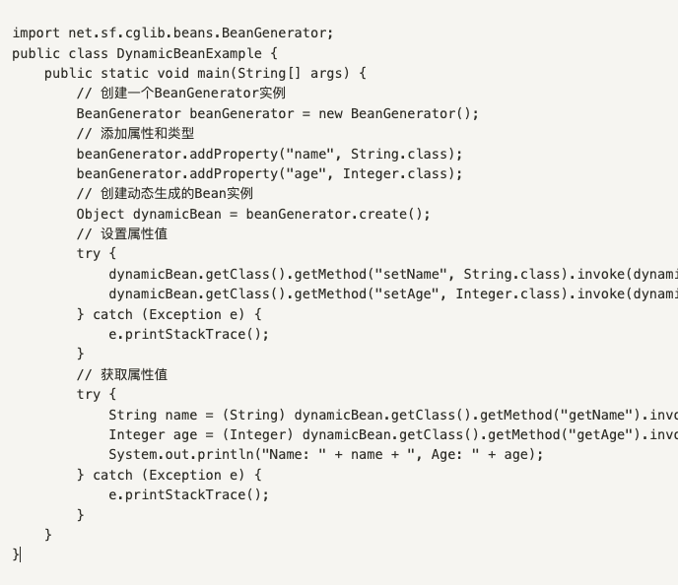
林俊佑
調用範例

Slide 46
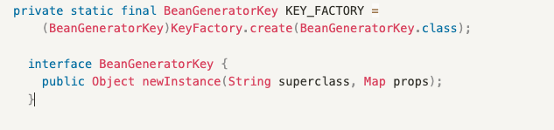
林俊佑
從 public class BeanGenerator extends AbstractClassGenerator 可以看到其繼承的對象，該類對象可以說是 CGLIB 的核心，Proxy 中的服務入口 Enhencer 就是該對象的繼承, 所以可以理解該類別的定位也是作為動態產生 class 的核心邏輯物件。不過是目標從一般 class 改成針對 Bean。
可以看到使用 static 創建了共用的 KEY_FACTORY , 且該 KEY_FACTORY 為介面, 所以在應該存在不同種的工廠。但這裡使用 Bean 用的

Slide 47
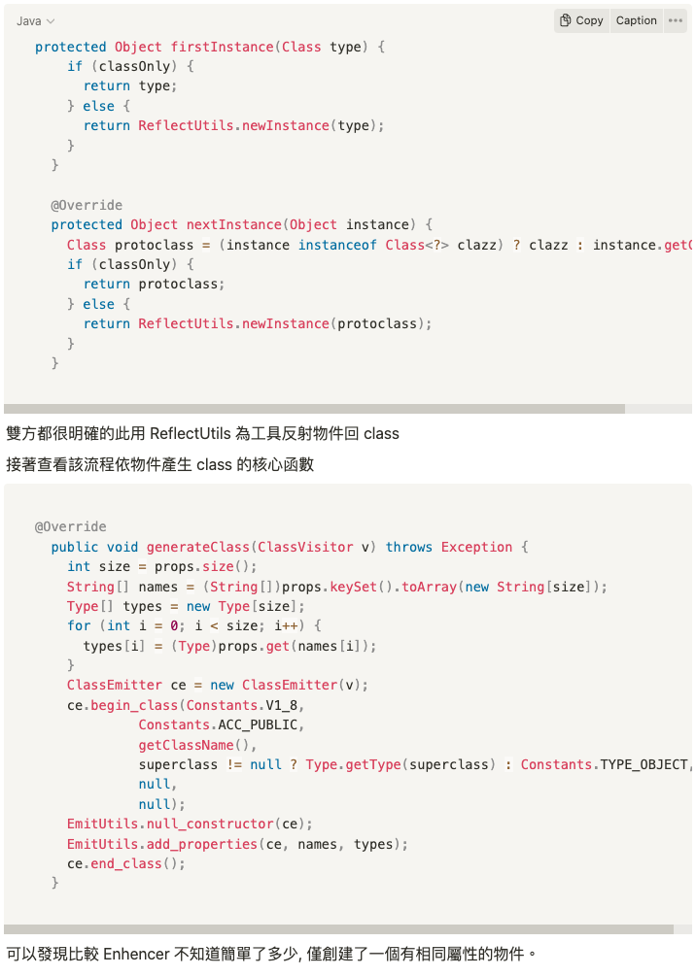
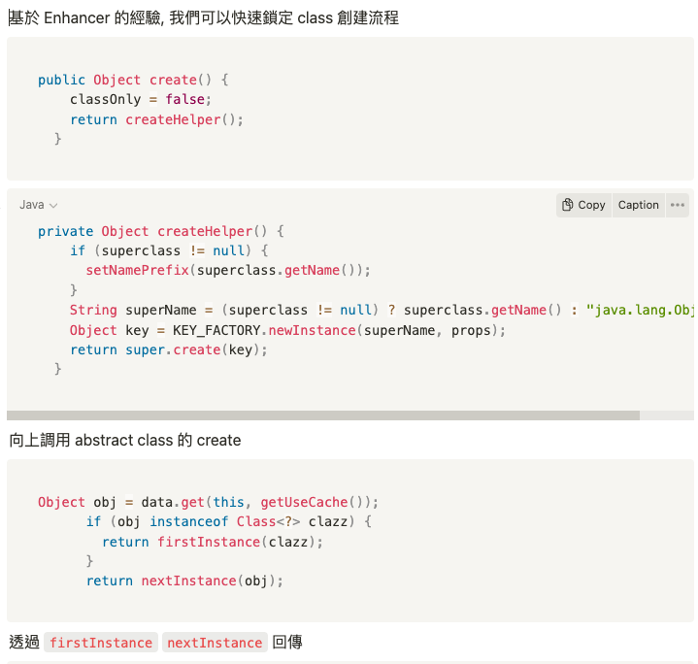
林俊佑

Slide 48
林俊佑
完整 trace code 紀錄
https://leon1234858.notion.site/W11-a2d68b4c0ba946519bfbc97e73e5286d?pvs=4

